Slide 1
Word Vectors - FastText, ELMo
Natural Language Processing
(based on revision of Chris Manning Lectures)

Slide 2
Announcement
TA announcements (if any)...

Slide 3
Suggested Readings
Contextual Word Representations: A Contextual Introduction
The Illustrated BERT, ELMo, and co.

Slide 4
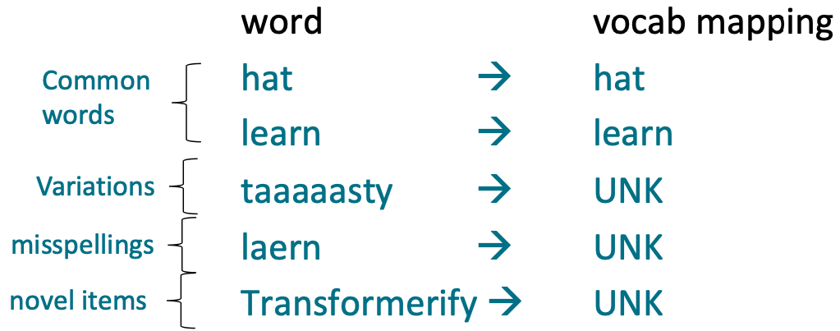
Unknown (UNK)
All novel words seen at test time are mapped to a single UNK

Slide 5
Treating language as “words” does not make sense
Many languages exhibit complex morphology, or word structure
Example: Swahili verbs can have hundreds on conjugations, each encoding a wide variety of information. (Tense, mood, definiteness, negation, information, about the object, ++)
Thus researchers have started exploring character-based model, hybrid-based model, and subword-based models…..
TLDR: Such model appear more effective, especially on solving out-of-vocabulary problems.

Slide 6
Three approaches
Pure character level model
Helps OOV problem
Treat each character separately
Time-consuming and not efficient really….
Hybrid model
Helps OOV problem
Treat only unknown words as characters
Still time consuming
Sub-word models
Uses word segmentation algorithms
Treat some word as word, and some subwords as individual word
Best of both worlds (subwords + words)

Slide 7
Pure character level model

Slide 8
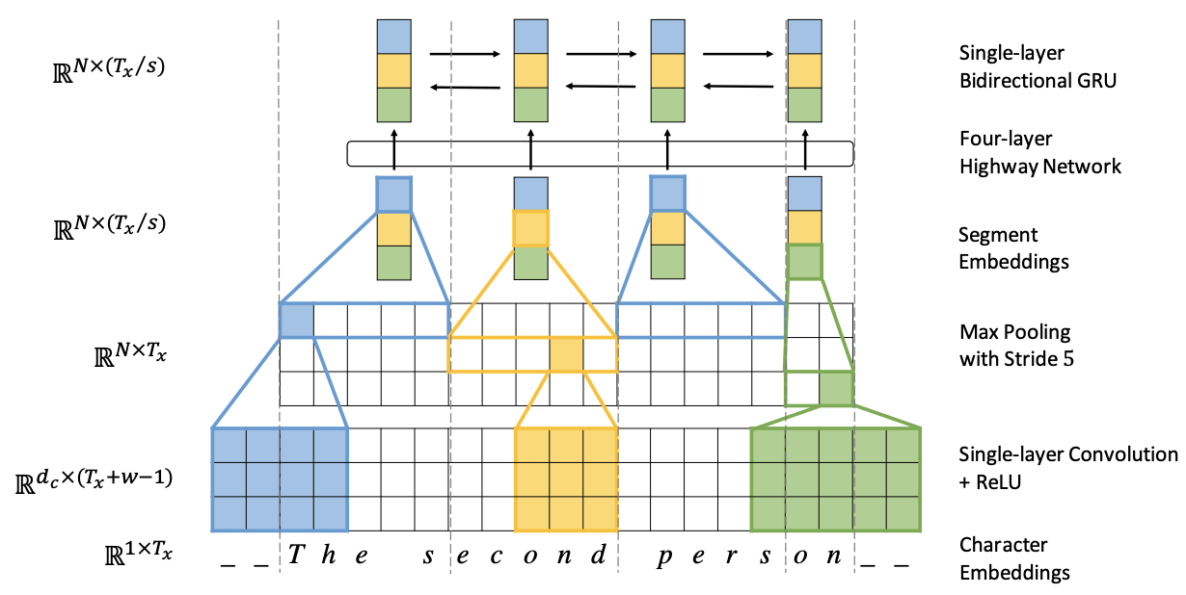
Pure character level model [Lee et al., ACL 2017]
Picture on the left is the encoder. The decoder is a char-level GRU.
In Cs-En, they found that when the decoder is character-based (i.e., character-based beam search), BLEU increased by around 2, where compared to subword-based beam search….However, char-based encoder shows no improvements over subwords….
Fully Character-Level Neural Machine Translation without Explicit Segmentation, Lee et al., 2017, https://aclanthology.org/Q17-1026.pdf

Slide 9
Hybrid model

Slide 10
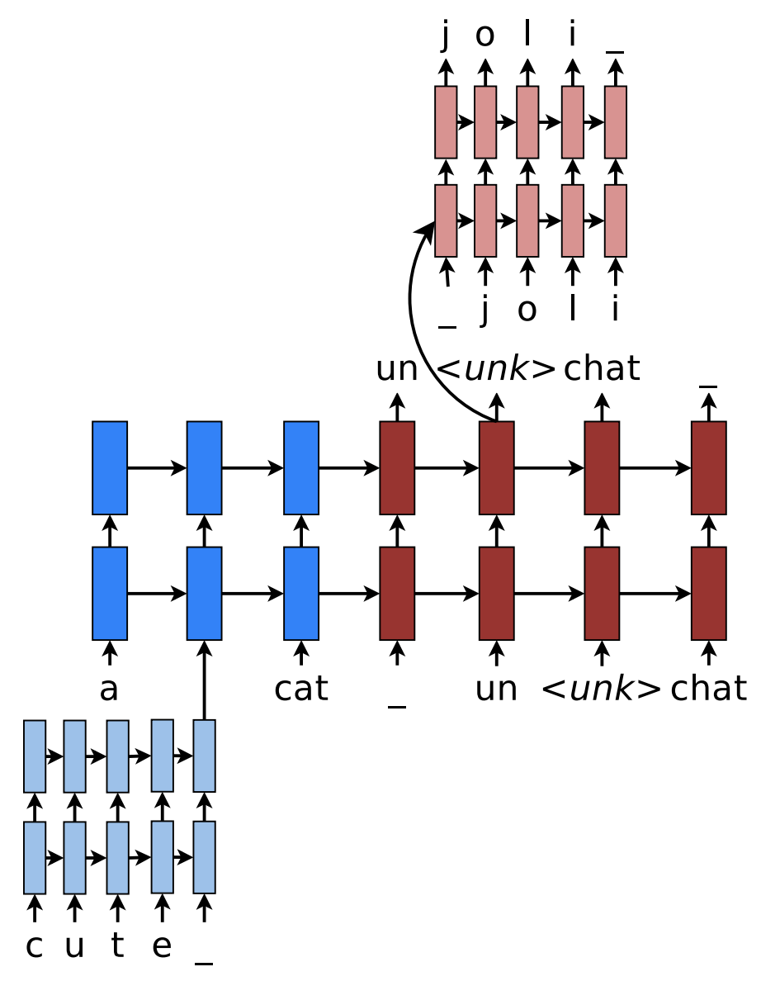
Hybrid Word-Character Models [Luong and Manning, ACL 2016]
Translating “a cute cat” (English) into “un joli chat” (French)
For rare tokens, here is the word “cute”, the rare token will be first inputted into some character-based LSTM to learn the representations. “_” is the boundary (similar to <START>)
During teacher forcing, the target of this rare word will be set as “<unk>”
For any “unk” symbol at that time step, the symbol will be further inputted into a char-based LSTM to retrieve the word (i.e., char-level beam search). Here in French, cute is “joli”
Achieving Open Vocabulary Neural Machine Translation with Hybrid Word-Character Models, Luong and Manning, 2016, https://arxiv.org/pdf/1604.00788.pdf

Slide 11
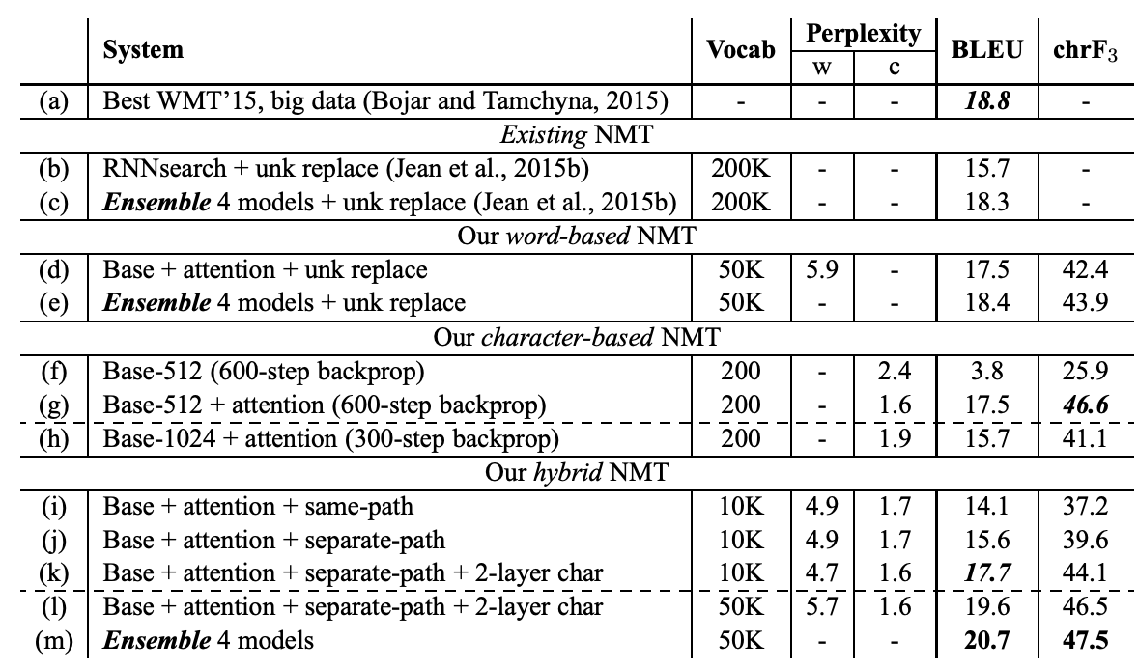
Hybrid Word-Character Models

Slide 12
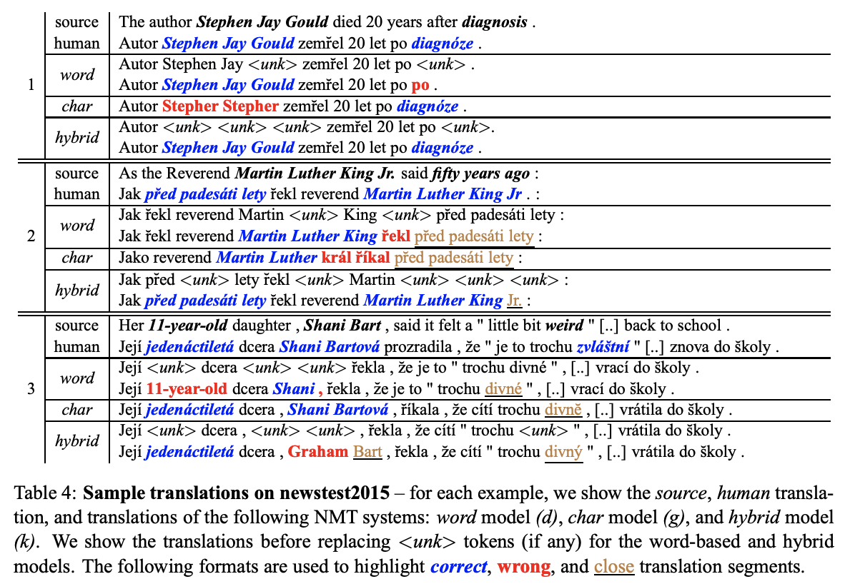
Hybrid Word-Character Models
In the first example, the hybrid model translates perfectly. The word-based model fails to translate “diagnosis” because the second <unk> was incorrectly aligned to the word “after”.
The character-based model, on the other hand, makes a mistake in translating names.

Slide 13
Subword-based models

Slide 14
How do we “segment” words, so they are subwords?
Byte Pair Encoding is a word segmentation algorithm
Start with a vocabulary of characters
Most frequent n-gram pairs -> a new gram
Dictionary
Vocabulary
5 l o w
2 l o w e r
6 n e w e s t
3 w i d e s t
l, o, w, e, r, n, w, s, t, i, d
Start with all characters in vocab

Slide 15
How do we “segment” words, so they are subwords?
Byte Pair Encoding is a word segmentation algorithm
Start with a vocabulary of characters
Most frequent n-gram pairs -> a new gram
Dictionary
Vocabulary
5 l o w
2 l o w e r
6 n e w e s t
3 w i d e s t
l, o, w, e, r, n, w, s, t, i, d, es
Add a pair (e, s) with freq 9

Slide 16
How do we “segment” words, so they are subwords?
Byte Pair Encoding is a word segmentation algorithm
Start with a vocabulary of characters
Most frequent n-gram pairs -> a new gram
Dictionary
Vocabulary
5 l o w
2 l o w e r
6 n e w e s t
3 w i d e s t
l, o, w, e, r, n, w, s, t, i, d, es, est
Add a pair (es, t) with freq 9

Slide 17
How do we “segment” words, so they are subwords?
Byte Pair Encoding is a word segmentation algorithm
Start with a vocabulary of characters
Most frequent n-gram pairs -> a new gram
Dictionary
Vocabulary
5 l o w
2 l o w e r
6 n e w e s t
3 w i d e s t
l, o, w, e, r, n, w, s, t, i, d, es, est, lo
Add a pair (l, o) with freq 7

Slide 18
How do we “segment” words, so they are subwords?
Stop when we reach our desired vocabulary size
Google NMT uses a variant of this called “Word Piece” model
Very similar, i.e., instead of using n-gram frequencies, they used n-gram that maximally reduces perplexity
BERT uses a variant of the wordpiece model
(Relatively) common words are in the vocabulary
at, fridge, 1910s
Other words are built from wordpieces:
Hypatia = h ##yp ##ati ##a
Non-word-initial units are prefixed with ## (different system uses slightly different ways to annotate)
Now, subwords are used prominently in most pre-trained models

Slide 19
FastText

Slide 20
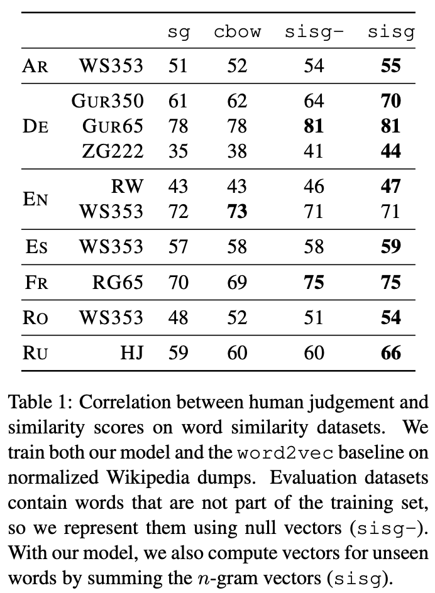
FastText [Bojanowski et al., ACL 2017]
Same author as Word2vec
Train similarly like Word2vec with skip-gram architecture
But represent words as n-grams.
For example, let say n=3
where = <wh, whe, her, ere, re>, <where>
Note that “<” and “>” are considered as characters
Represent word as sum of these representations
Enriching Word Vectors with Subword Information, Bojanowski et al., 2017, https://arxiv.org/pdf/1607.04606.pdf

Slide 21
ELMo

Slide 22
Problems of Word Embeddings
Originally, we basically had one representation of words
The word vectors that we learned about at the beginning
Word2vec, GloVe, fastText
These have two problems:
Always the same representation for a word type regardless of the context in which a word token occurs
We just have one representation for a word, but words have different aspects, including semantics, syntactic behavior, and register/connotations

Slide 23
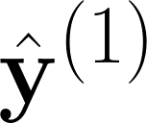
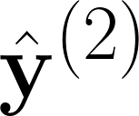
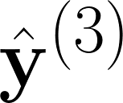
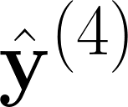

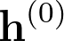
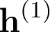
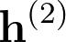
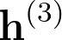
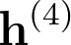
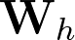

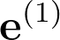
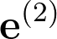
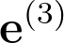
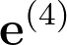

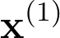
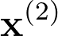
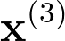
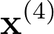
We actually already have a solution all along!
the
boy
is
happy
These hidden states actually embed contextual information!
Why not we train LM on a very large corpus, and take these hidden states for other purposes, e.g., classification?
sample
sample
sample
sample
<START>
the
boy
is

Slide 24
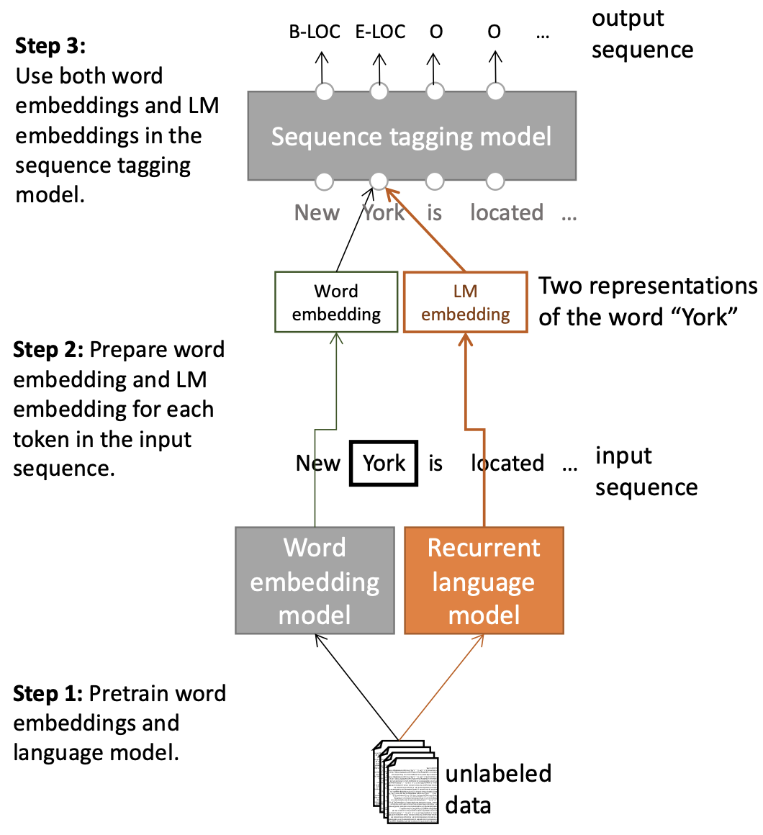
Tag LM [Peters et al. ACL 2017]
Semi-supervised sequence tagging with bidirectional language models, Peters et al. 2017, https://arxiv.org/pdf/1705.00108.pdf

Slide 25
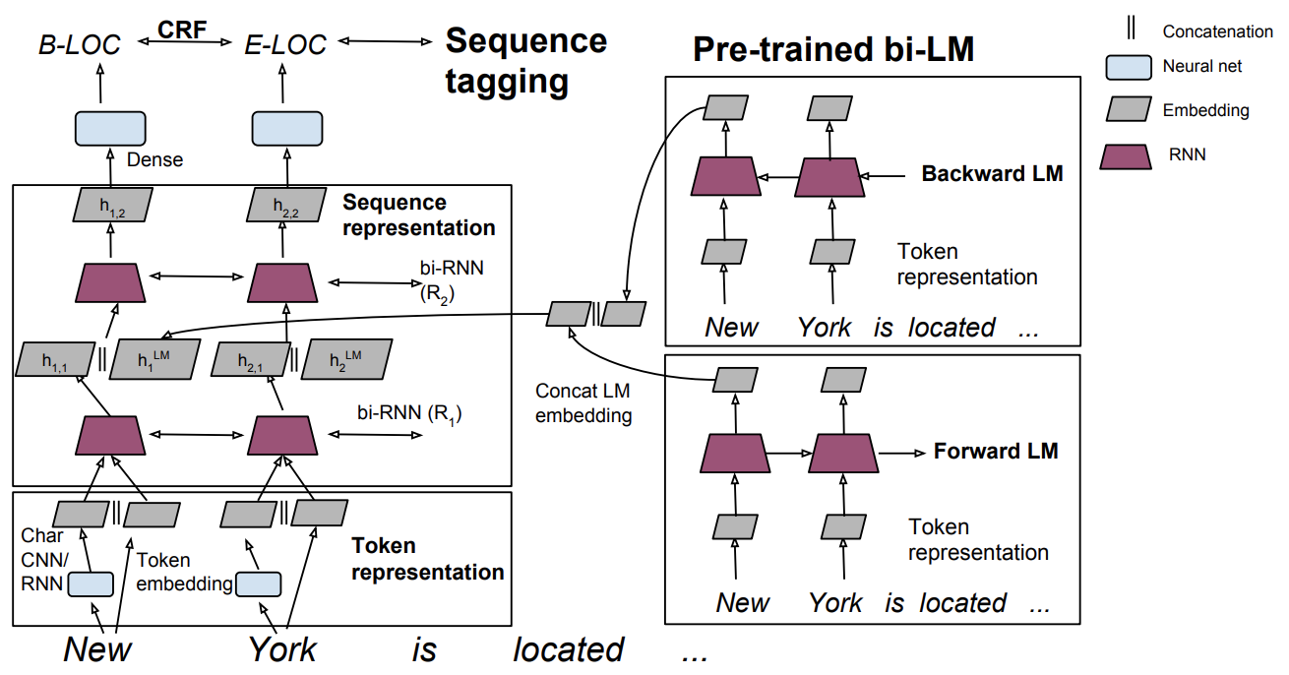
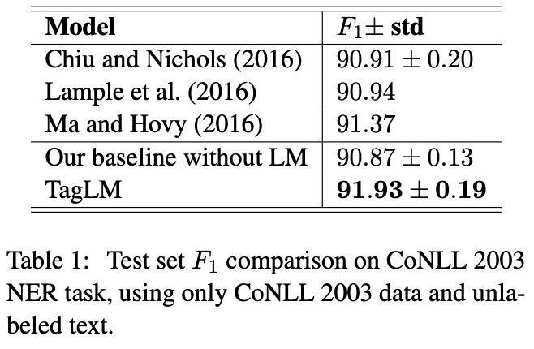
Tag LM

Slide 26
ELMo: Embeddings from Language Models [Peters et al. ACL 2018]
Learn a deep Bi-NLM and use all its layers in prediction
Use 2 biLSTM layers
First lower layer aims for lower-level syntax (POS, tagging, NER)
Higher layer is for higher level semantics (sentiment, semantic role, etc.)
First run biLSTM to get representations for each word
Took learned weighted average of the 2 hidden layers
Then let (whatever) end-task model use them
Freeze weights of ELMo for purposes of supervised model
Concatenate ELMo weights into task-specific model
Concatenating into intermediate layers just like TagLM
Can provide ELMo representations again, when producing outputs, e.g., in a question answering system
Deep contextualized word representations, Peters et al., 2018, https://arxiv.org/pdf/1802.05365.pdf

Slide 27
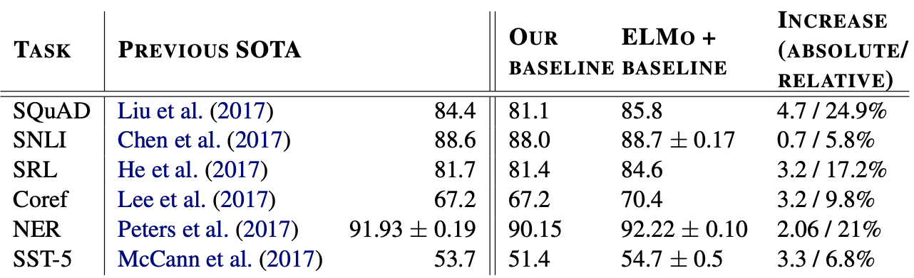
ELMo: Embeddings from Language Models

Slide 28
Summary
Char-based models (similar to hybrid models) seem to be able to address out-of-vocabulary problem, but they are very slow to run...thus did not really receive much attention after 2017...
Word embeddings such as Word2vec and GloVe suffers from out-of-vocabulary problem
FastText kinda addresses it
Using the hidden states as contextual vectors - the core idea behind ELMo
Later on Analysis of Model’s Inner Workings, scientists actually really find amazing things inside each hidden states of a huge pretrained model!
ELMo and ULMfit are among many inspirations behind BERT and other pretrained models
Later on, pretrained models like BERT is even better, since the way of training of a large corpus without labels (i.e., semi-supervised learning) is even better than ELMo.

